Slide 1
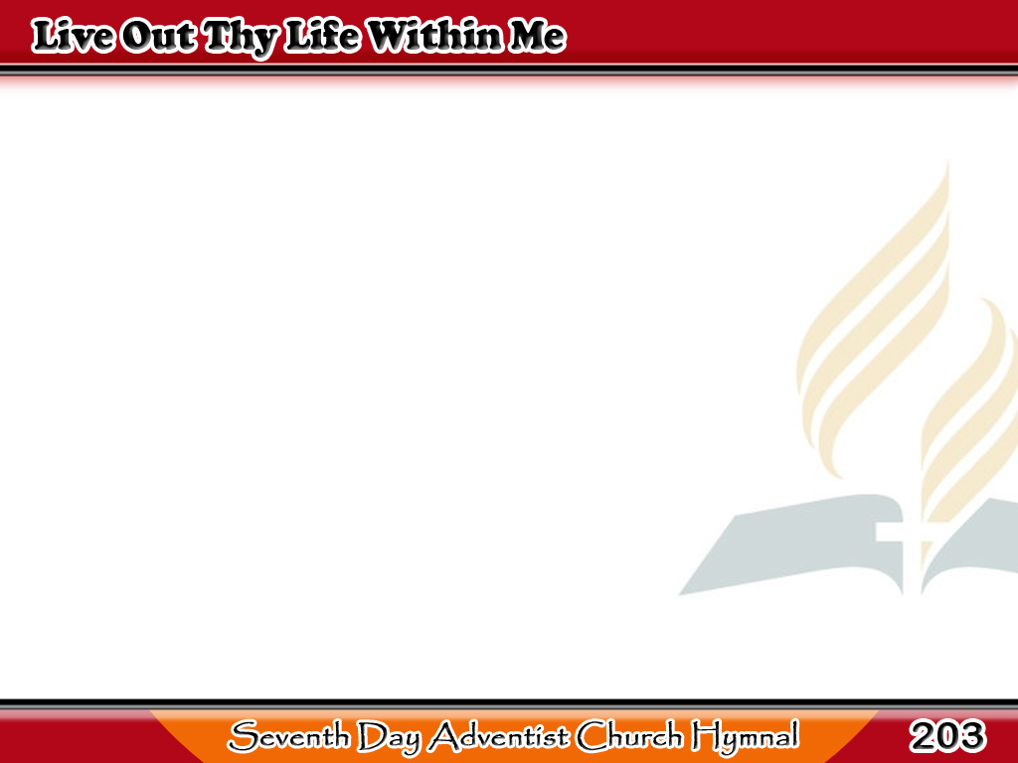
Buhay Mo’y Isaakin
Live out Thy life within me,
O Jesus, King of kings!
Be Thou Thyself the answer
To all my questionings;
1/4

Slide 2
Buhay Mo’y Isaakin
Live out Thy life within me,
In all things have Thy way!
I, the transparent medium
Thy glory to display.
1/4

Slide 3
Buhay Mo’y Isaakin
The temple has been yielded,
And purified of sin;
Let Thy Shekinah glory
Now shine forth from within,
2/4

Slide 4
Buhay Mo’y Isaakin
And all the earth keep silence,
The body henceforth be
Thy silent, gentle servant,
Moved only as by Thee.
2/4

Slide 5
Buhay Mo’y Isaakin
Its members every moment
Held subject to Thy call,
Ready to have Thee use them,
Or not be used at all;
3/4

Slide 6
Buhay Mo’y Isaakin
Held without restless longing,
Or strain, or stress, or fret,
Or chafings at Thy dealings,
Or thoughts of vain regret.
3/4

Slide 7
Buhay Mo’y Isaakin
But restful, calm, and pliant,
From bend and bias free,
Awaiting Thy decision,
When Thou hast need of me.
4/4

Slide 8
Buhay Mo’y Isaakin
Live out Thy life within me,
O Jesus, King of kings!
Be Thou the glorious answer
To all my questionings.
4/4

